Slide 1
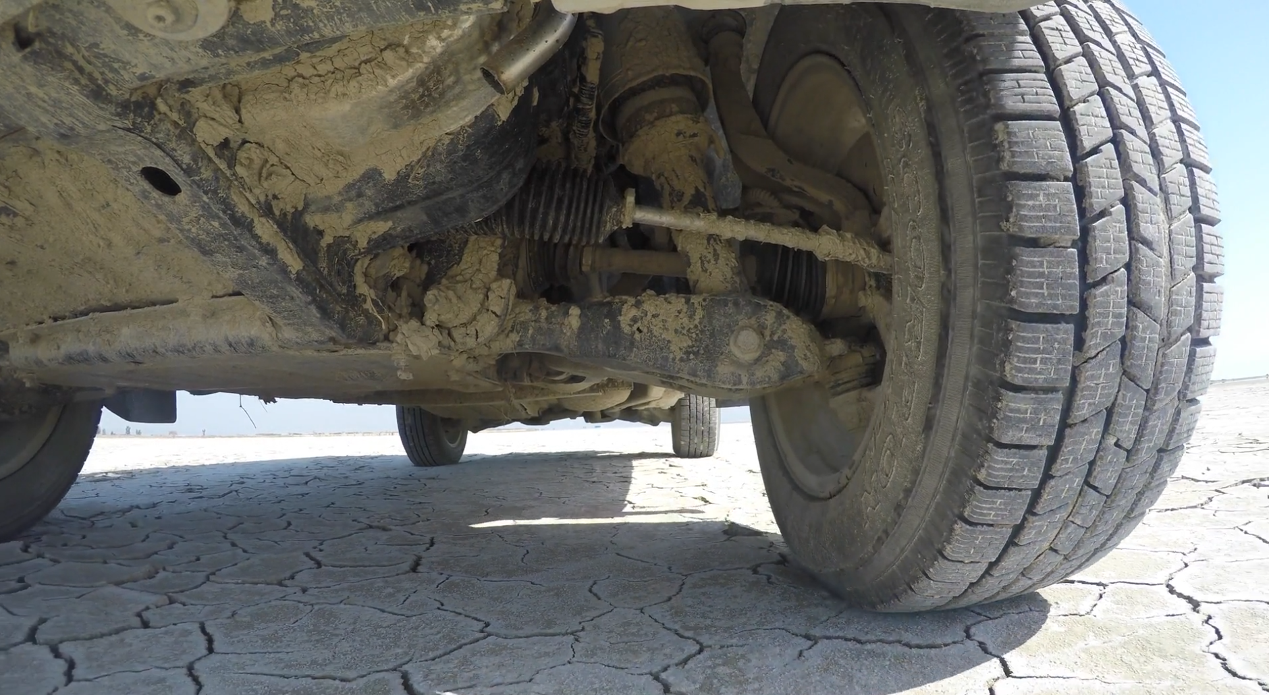
Vibration isolation
Forced vibration
Tyler Dare

Slide 2
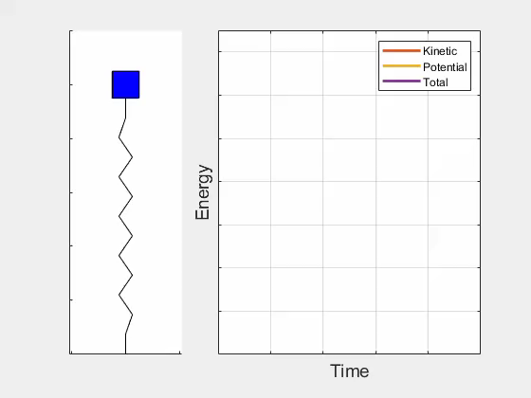
Energy in undamped systems

Slide 3
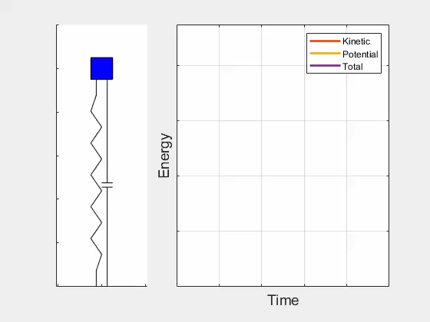
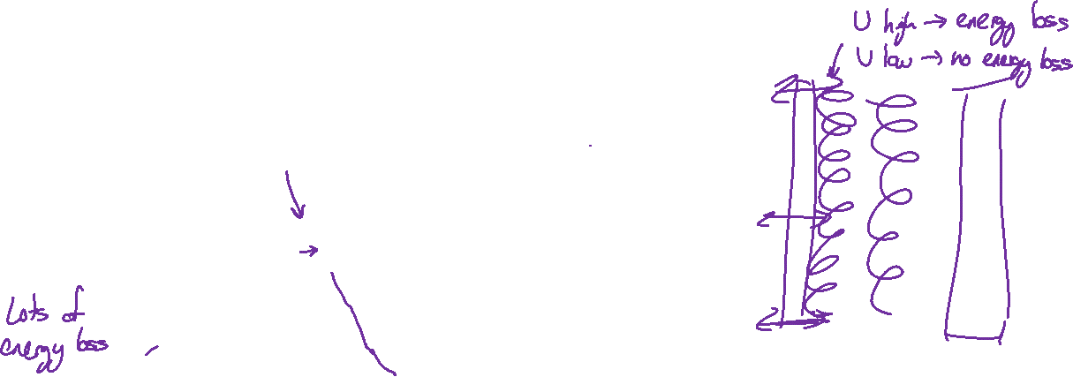
Energy in underdamped systems

Slide 4
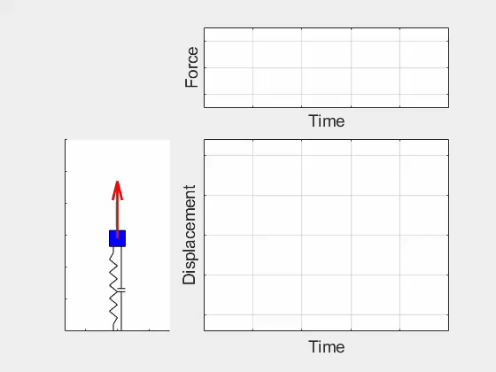
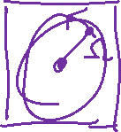
Forced oscillator

Slide 5
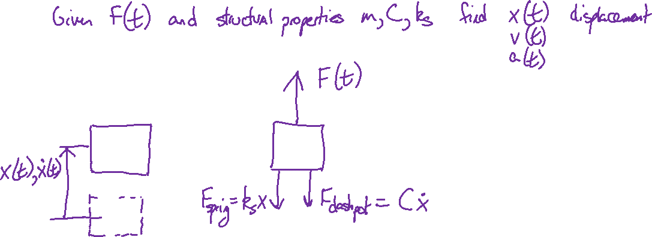
Free body diagram with damping and forcing

Slide 6
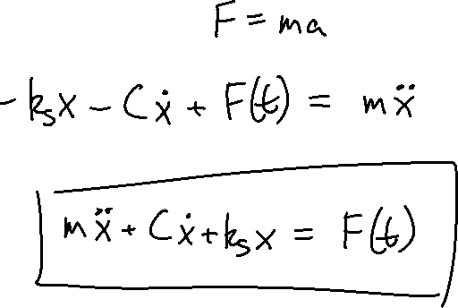
Forced equation of motion
Newton’s second law:

Slide 7

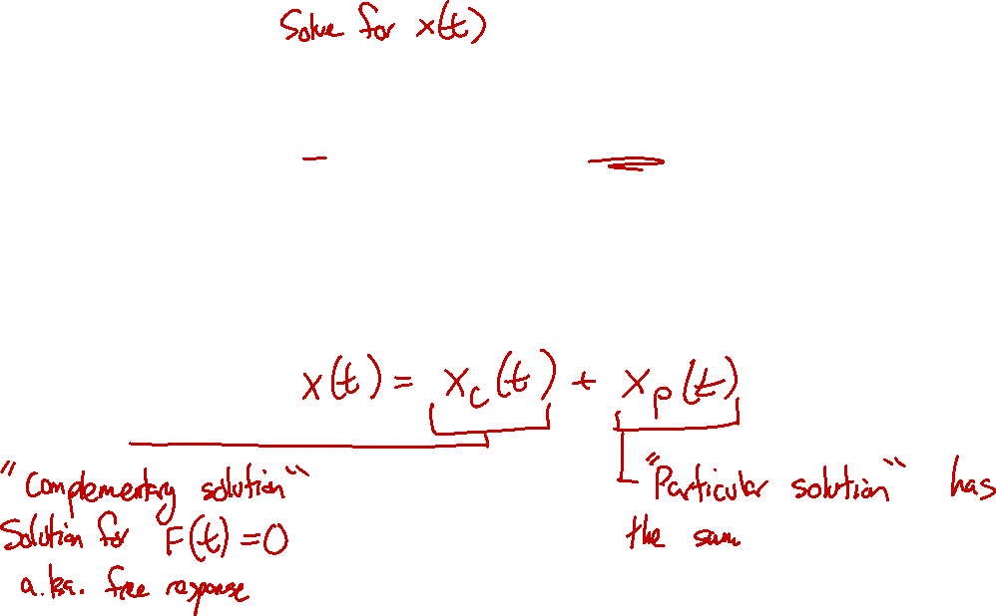

Forced oscillations
$$m\ddot{x}+C\dot{x}+k_{s}x=F(t)$$
If $F\left(t\right)≠0$, then the system will have a different response to the damped oscillator.
The total response will be

Slide 8
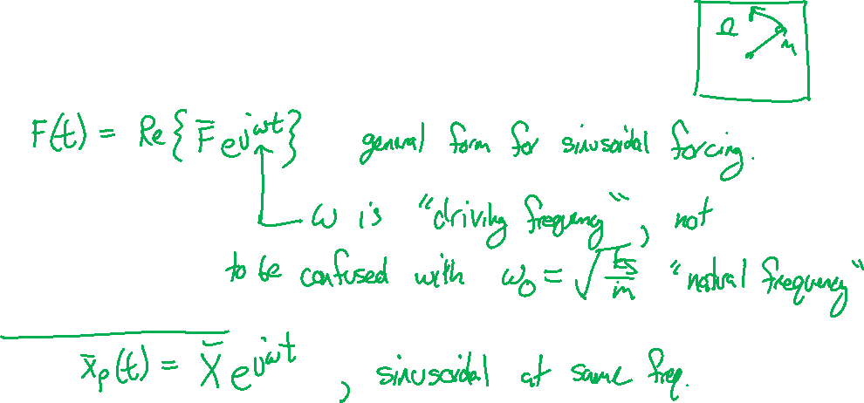

Forced oscillations
$$m\ddot{x}+C\dot{x}+k_{s}x=F(t)$$
For now, assume that $F(t)$ is sinusoidal,
Then the particular solution has the same form as $F(t)$,

Slide 9
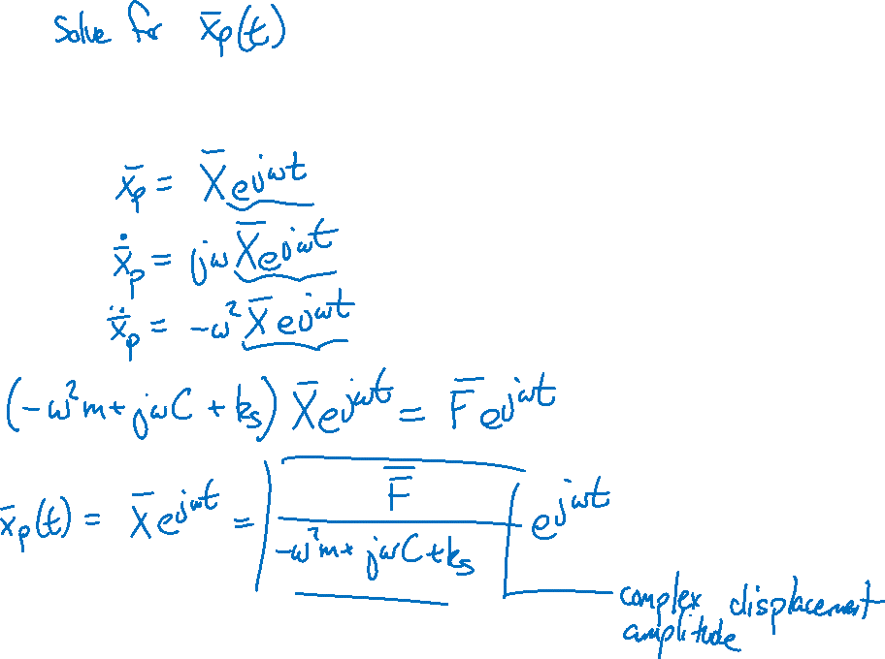

Forced oscillations
$$m\ddot{x}+C\dot{x}+k_{s}x=\overline{F}e^{jωt}$$

Slide 10
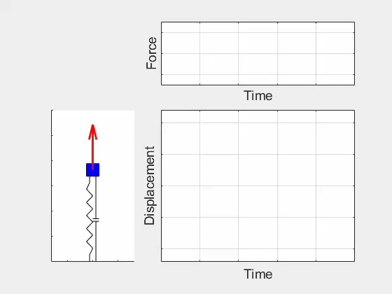

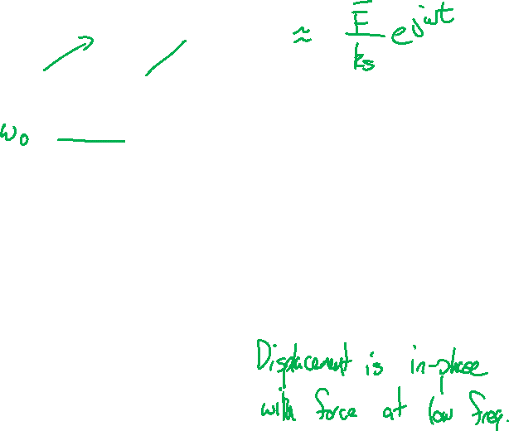
Forced oscillations
$${\overline{x}}_{p}\left(t\right)=\overline{X}e^{iωt}=\frac{\overline{F}e^{jωt}}{\left(−ω^{2}m+jωC+k_{s}\right)}$$
Low frequencies: $ω≪ω_{d}$, ${\overline{x}}_{p}\left(t\right)≈\frac{\overline{F}}{k_{s}}e^{jωt}$

Slide 11


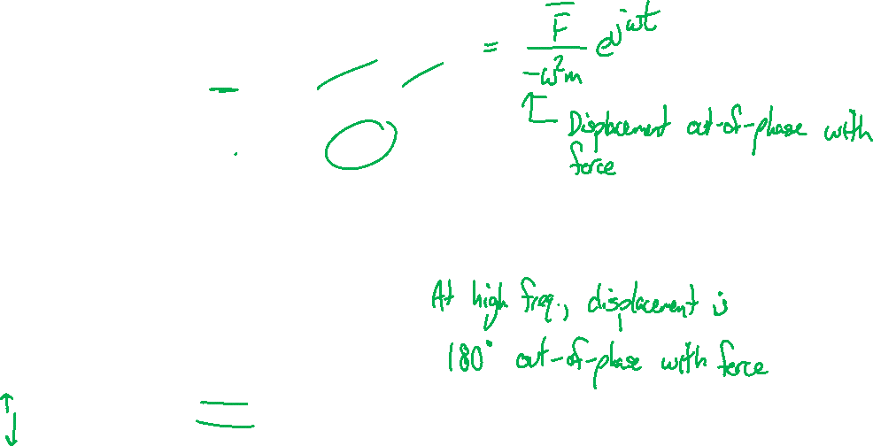
Forced oscillations
$${\overline{x}}_{p}\left(t\right)=\overline{X}e^{iωt}=\frac{\overline{F}e^{jωt}}{\left(−ω^{2}m+jωC+k_{s}\right)}$$
High frequencies: $ω≫ω_{d}$, ${\overline{x}}_{p}\left(t\right)≈\frac{\overline{F}}{−ω^{2}m}e^{jωt}$

Slide 12

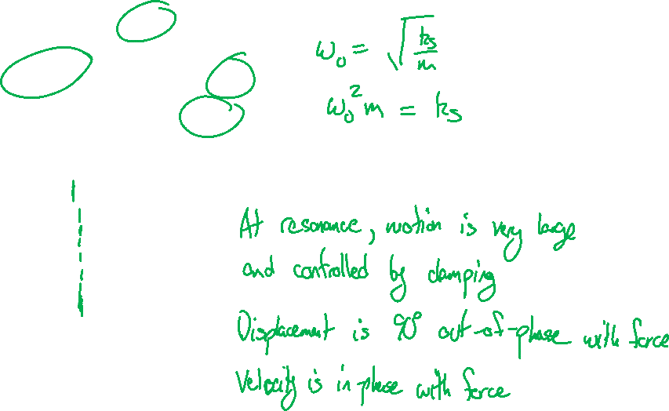
Forced oscillations
$${\overline{x}}_{p}\left(t\right)=\overline{X}e^{iωt}=\frac{\overline{F}e^{jωt}}{\left(−ω^{2}m+jωC+k_{s}\right)}$$
Near resonance: $ω≈ω_{d}$, ${\overline{x}}_{p}\left(t\right)≈\frac{\overline{F}}{jωc}e^{jωt}$

Slide 13
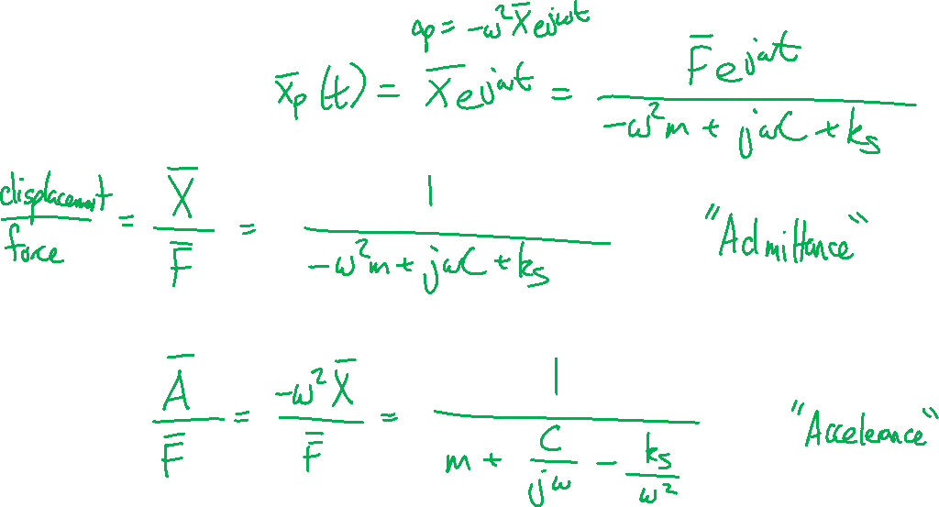

Frequency response functions
$${\overline{x}}_{p}\left(t\right)=\overline{X}e^{iωt}=\frac{\overline{F}e^{jωt}}{\left(−ω^{2}m+jωC+k_{s}\right)}$$
$$\frac{\overline{X}}{\overline{F}}=\frac{1}{\left(−ω^{2}m+jωC+k_{s}\right)}$$
“Admittance”
$$\frac{\overline{A}}{\overline{F}}=\frac{−ω^{2}\overline{X}}{\overline{F}}=\frac{1}{\left(m+\frac{C}{jω}−\frac{k_{s}}{ω^{2}}\right)}$$
“Accelerance”

Slide 14
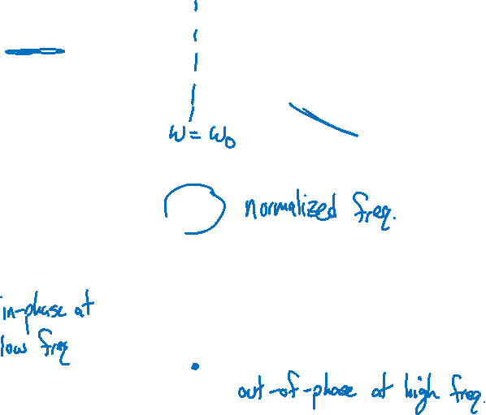
Frequency response functions

Slide 15

Frequency response functions

Slide 16

Frequency response functions

Slide 17
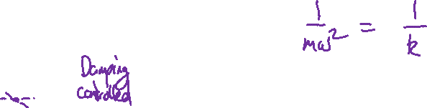
Frequency response functions

Slide 18
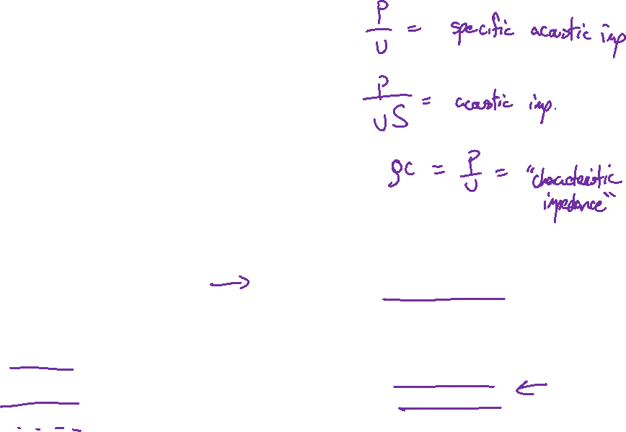
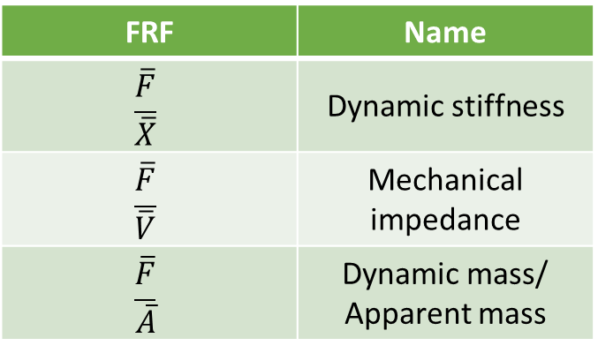
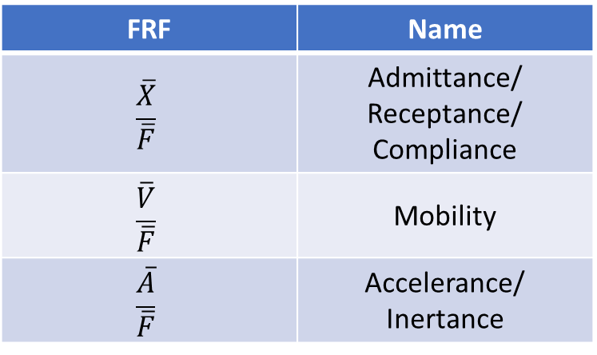

Frequency response functions
Displacement, ${\overline{x}}_{p}\left(t\right)=\overline{X}e^{jωt}$
Velocity, ${\overline{v}}_{p}\left(t\right)=\overline{V}e^{jωt}=jω\overline{X}e^{jωt}$
Acceleration, ${\overline{a}}_{p}\left(t\right)=\overline{A}e^{jωt}=−ω^{2}\overline{X}e^{jωt}$
FRF | Name
$$\frac{\overline{X}}{\overline{F}}$$ | Admittance/ Receptance/ Compliance
$$\frac{\overline{V}}{\overline{F}}$$ | Mobility
$$\frac{\overline{A}}{\overline{F}}$$ | Accelerance/ Inertance
FRF | Name
$$\frac{\overline{F}}{\overline{X}}$$ | Dynamic stiffness
$$\frac{\overline{F}}{\overline{V}}$$ | Mechanical impedance
$$\frac{\overline{F}}{\overline{A}}$$ | Dynamic mass/ Apparent mass

Slide 19
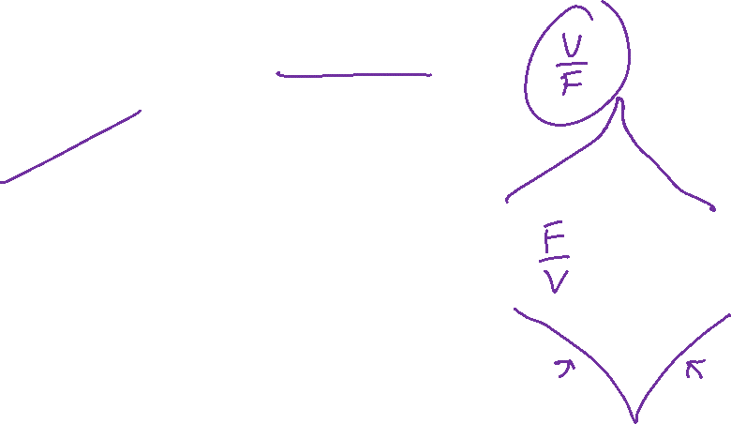

Slide 20
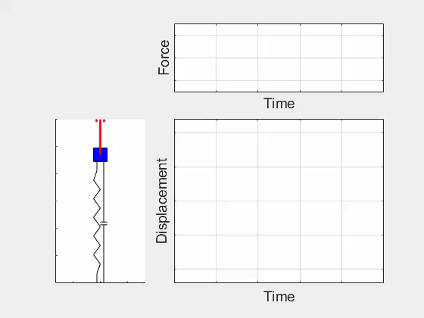
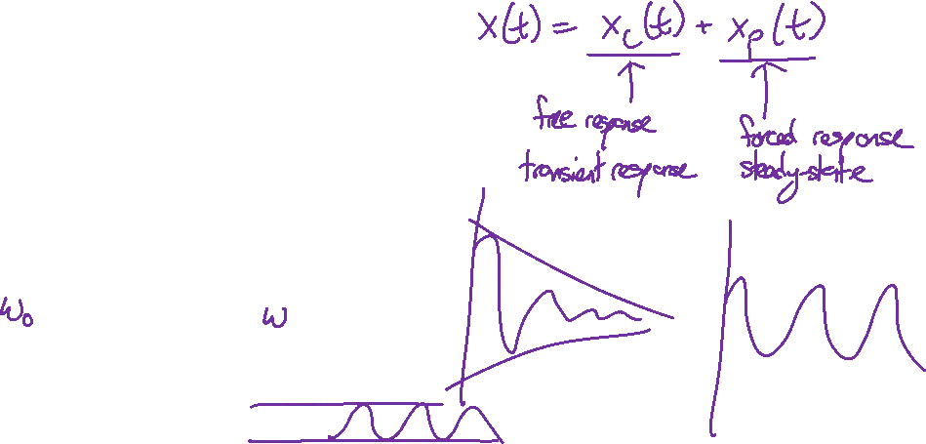
Transient plus steady-response

Slide 21
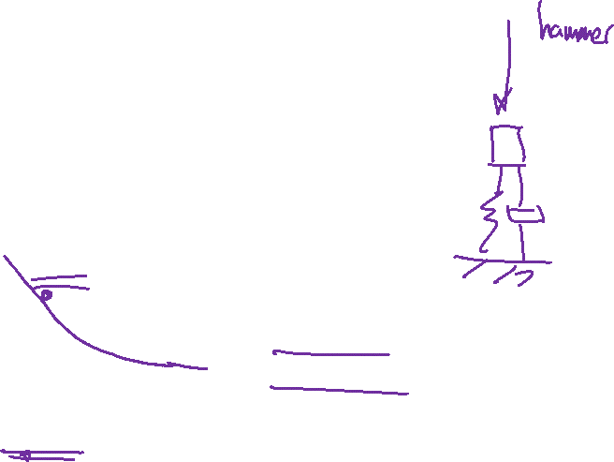
Transient plus steady-response

Slide 22
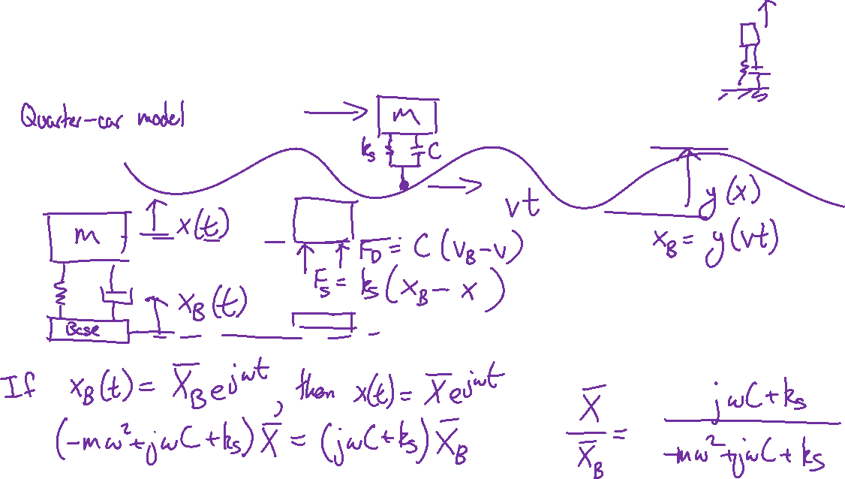
Base excitation
Instead of forcing the mass, we can model the base as moving.

Slide 23
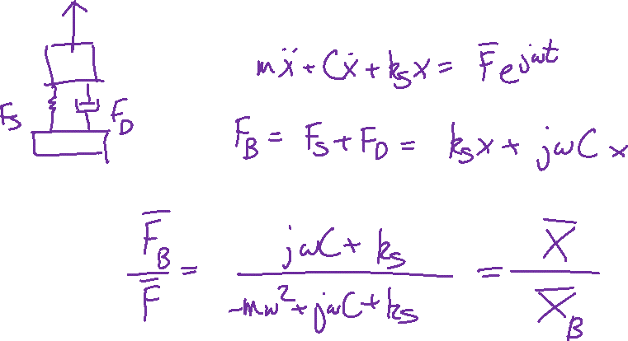
Base excitation
If a force is applied to a machine, how much force is transmitted to the base?

Slide 24
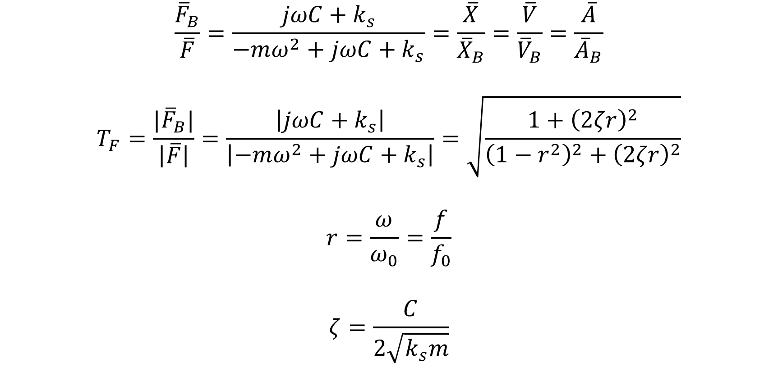
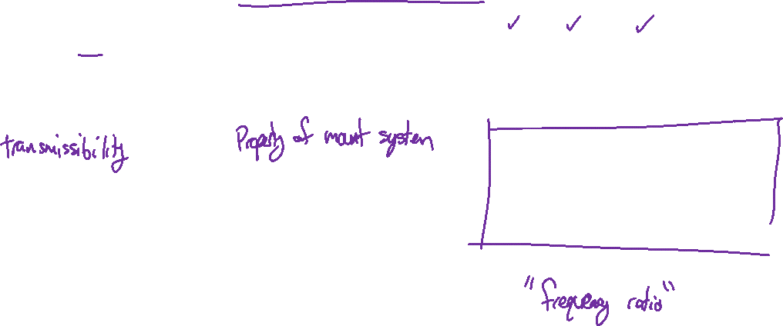
Transmissibilities for single-stage isolators
$$\frac{{\overline{F}}_{B}}{\overline{F}}=\frac{jωC+k_{s}}{−mω^{2}+jωC+k_{s}}=\frac{\overline{X}}{{\overline{X}}_{B}}=\frac{\overline{V}}{{\overline{V}}_{B}}=\frac{\overline{A}}{{\overline{A}}_{B}}$$
$$T_{F}=\frac{{|\overline{F}}_{B}|}{\left|\overline{F}\right|}=\frac{\left|jωC+k_{s}\right|}{\left|−mω^{2}+jωC+k_{s}\right|}=\sqrt{\frac{1+{\left(2ζr\right)}^{2}}{{\left(1−r^{2}\right)}^{2}+{\left(2ζr\right)}^{2}}}$$
$$r=\frac{ω}{ω_{0}}=\frac{f}{f_{0}}$$
$$ζ=\frac{C}{2\sqrt{k_{s}m}}$$

Slide 25
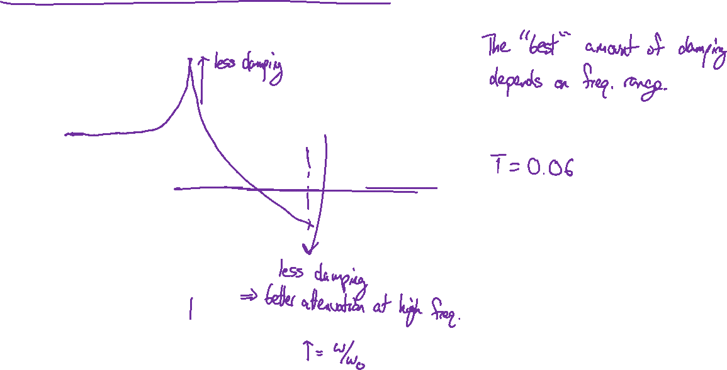
Transmissibilities for single-stage isolators

Slide 26
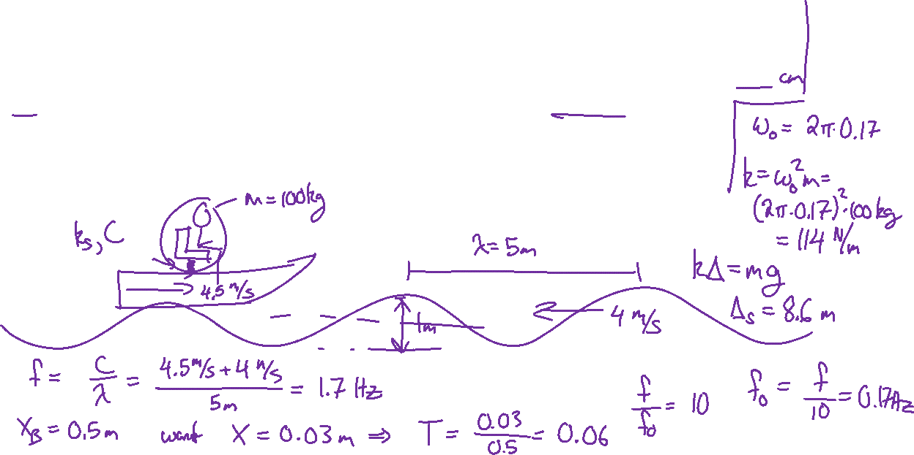
Example problem: Boat seat suspension
Design a single stage suspension for a boat seat that has less than ± 3 cm of displacement when traveling into 1 m high (pk-pk) surface waves with a wavelength of 5 m and a speed of 4 m/s. The boat is traveling at 4.5 m/s into the waves. The mass of the seat plus the driver is 100 kg.

Slide 27
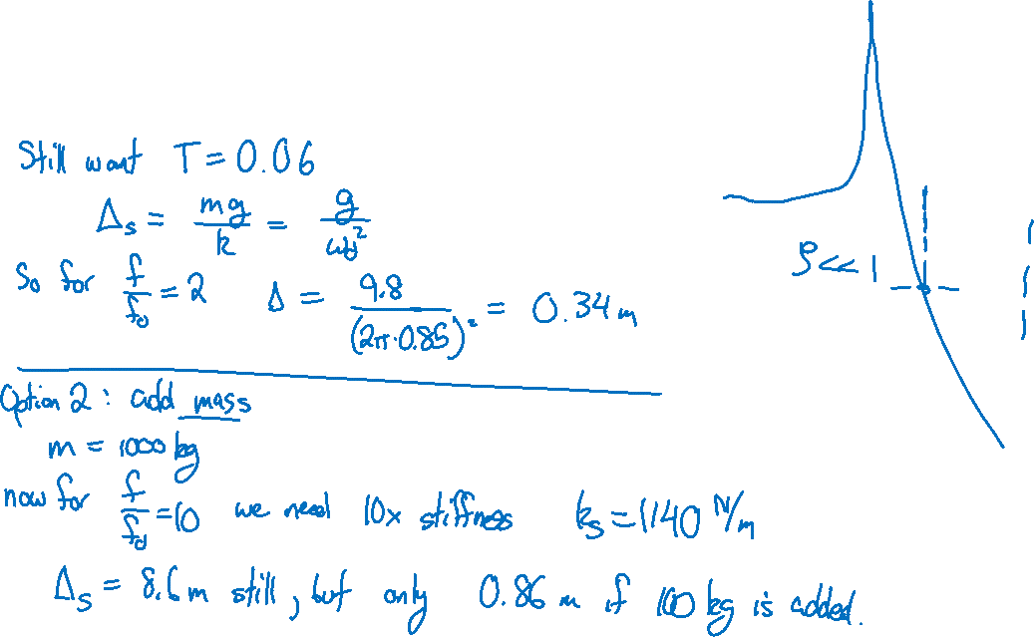
Example problem: Boat seat suspension
Explore alternative solutions:

